Slide 1
ENGI 301 M&M Addiction Proposal
9/26/2022
Anas Yousaf

Slide 2
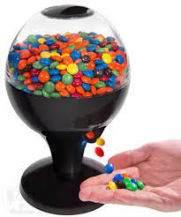
Background Information
I want to create a candy (M&M) dispenser that is activated by waving my hand and shows me how much candy I have left
My brother and I both love M&Ms and I buy a share packet or several almost every time I go to the store. I also love trying out different flavors of M&Ms and my brother and I rank them
If possible, I want to design the sensor so that the longer I wave my hand, the more it dispenses, and to design the sensor to be able to differentiate between different types of M&Ms
If the project ends up really good, I might give it to my brother as a gift or use it as a decoration in my room

Slide 3
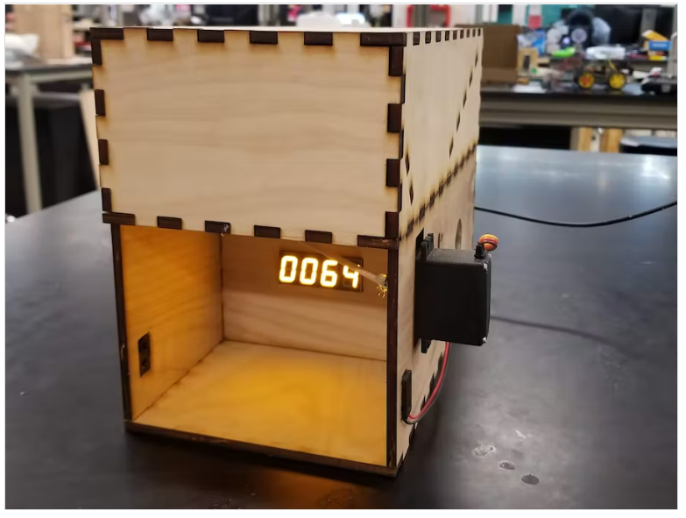
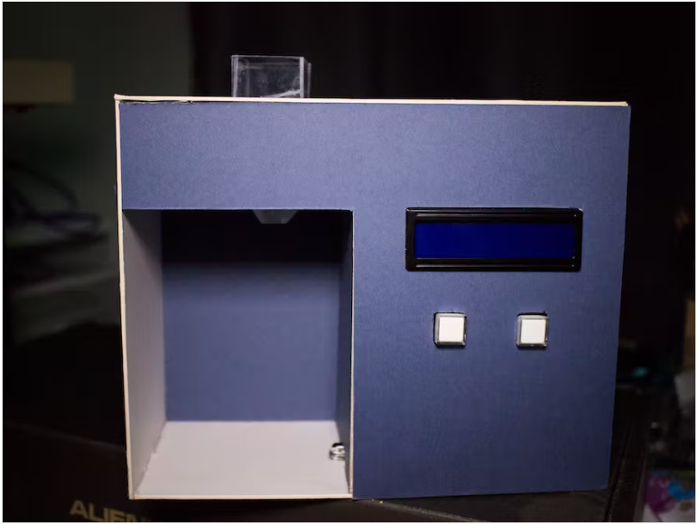
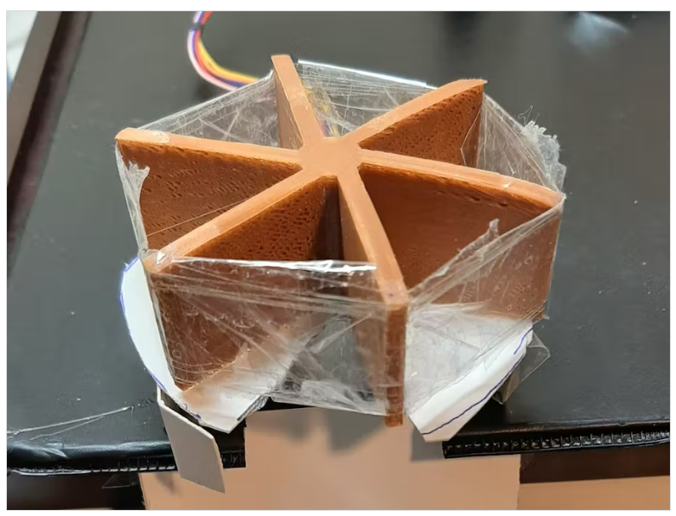
Existing Projects
Candy Dispenser with Music
https://www.hackster.io/nickericlester/ir-breakbeam-candy-dispenser-with-zelda-music-c76e65
Arduino Candy Dispenser
https://www.hackster.io/hadamiera/candy-dispenser-a61a60
Ferris Wheel Candy Dispenser
https://www.hackster.io/sherwinchiu89/candy-dispenser-with-3d-print-stepper-motor-d834fb

Slide 4
Improvements
The project that I will take the most inspiration from is the candy dispenser with music. That project already incorporates an IR sensor for hand motion to activate the dispenser and has a display that shows how much candy is remaining.
The Arduino candy dispenser will serve as a backup model for what the Arduino code and structure should look like and another model for what the dispenser could look like
I want to take inspiration from the Ferris wheel dispenser by looking at the shape and how the candy is dispensed
Overall, I want to improve on the music dispenser by implementing a design similar to the Ferris wheel that allows me to dispense a lot of candy at once instead of just one piece. Additionally, I want to improve on the remaining candy display and implement different formulas for different types of candy

Slide 5
System Block Diagram

Slide 6
Power Block Diagram

Slide 7
Components / Budget
Component | Need to Buy | Cost Per
Breadboard (Given) | 0 | $0
Adafruit 0.56” 4-Digit 7-Segment Display (Given) | 0 | $0
PocketBeagle (Given) | 0 | $0
Resistors (Given) | 0 | $0
Jumper Wires (Given) | 0 | $0
Wood (OEDK) | 0 | $0
IR Break Beam Sensor (Buy) | 2 | $2.95
Force-Sensitive Resistor Strip (Buy) | 2 | $7.39
360 Degree Servo 2-Pack (Buy) | 1 | $13.99
Rotary Encoder 5-Pack (Buy) | 1 | $9.99
Adafruit LCD Character Display (Buy) | 1 | $19.95

